Slide 1


ELEN-6893 Big Data Analysis
Final Project:
Automatic Image Labelling System
Group #3: Jing Peng, Jiashu Chen, Yi Yang
Date Performed: December 19rd, 2021

Slide 2
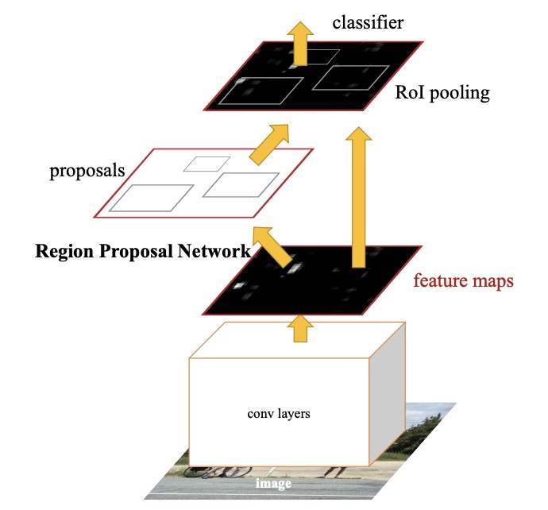
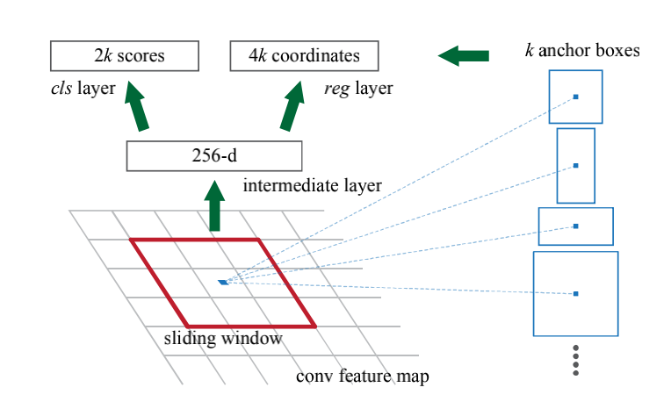
Methods - Algorithm
Faster-RCNN:
Region-based classification and detection
ResNet: Feature map extractor
Region Proposal Network: Two-stage detector to generate region proposals
Non-Maximum Suppression: Merge candidate region boxes
RoI Head branches: Classification and Bounding-box regression
Implement our experiments in PyTorch and visualize via OpenCV

Slide 3
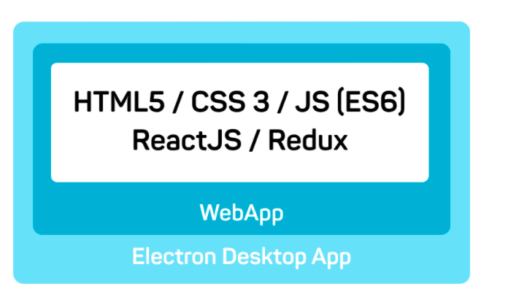

Methods - Software
Across platform application:
Front-end:
Framework: Electron + React + Semantic UI
Data interaction: Axios + React Hooks
Package: NPM
Back-end:
API: Flask
Deep-Learning Model
Database: MySQL8.0

Slide 4
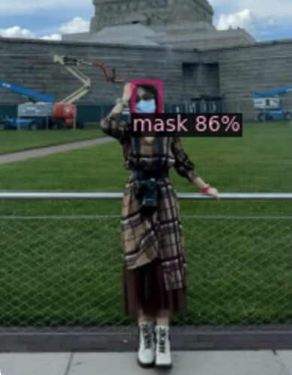
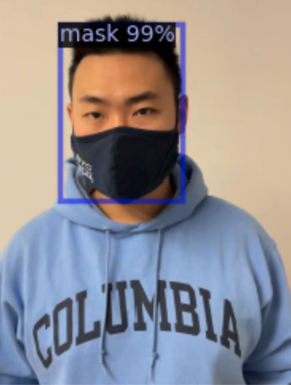
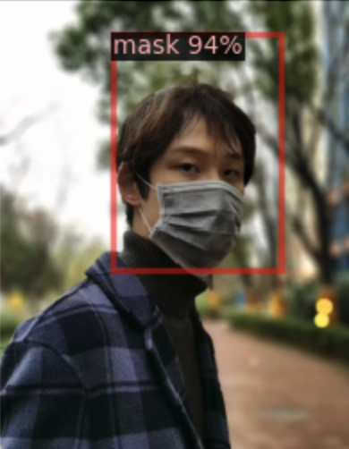
Current Results
Our model can detect targets in different colors, shapes and sizes
ResNet34 + RPN:
All training is done on GCP with one Tesla T4 GPU. Finished 20000 iterations in approximately 2 hours.
AP | AP50 | AP75 | APs | APm | APl
32.494 | 64.792 | 26.677 | 20.755 | 36.286 | 42.568

Slide 5
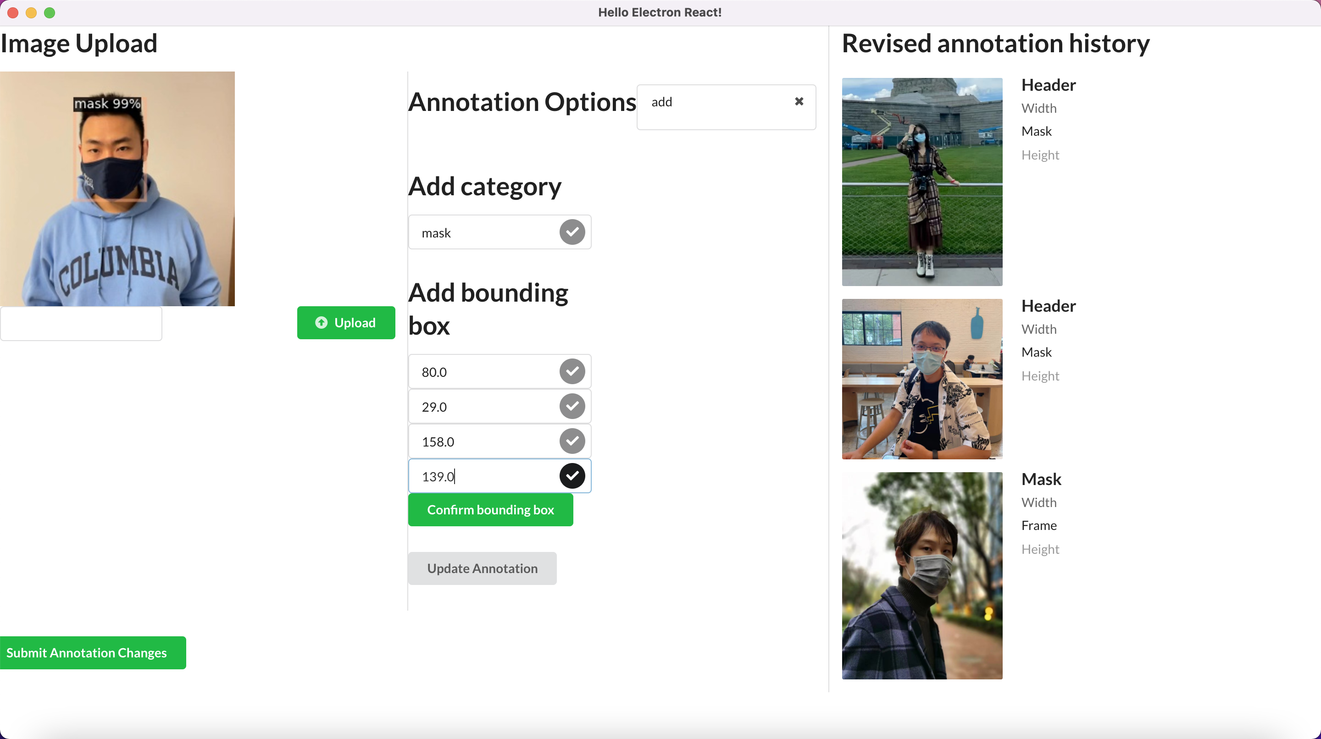
Current Results
Upload your image to be labelled through our software user interface.
Wait for annotations generated by our deep-learning model.
Make modifications to achieve a better result if necessary.
Confirm your labels and put it into training dataset.

Slide 6
Problems
Model divergence
Non-ideal initiation
Adjustment on learning rate
Warm-up training
Model Under-fitting
ResNet-18 seems to under-fit
Use a deeper net: ResNet-34/50
More epochs in the training process
Lack of variety in training dataset
Detect some specific types of targets
Enlarge the training dataset
Ensure that training data contains targets of different shapes and color, etc.

Slide 7
Evaluation
Deep-learning Model
Accuracy: AP as the most important criteria
Speed: How long it takes to process each image
Availability: Applicable to different targets and tasks
Software
Performance: Using Lazyload for images and components in the page.
Functions:
Annotations of uploaded images
Change of the annotations
add
delete
update

Slide 8
Future Work
Deep-learning Model
Model training function interface
Parameters tuning for better performance
Training dataset variety
Software
Display real-time change of bounding box
Periodically training of the deep-learning model
Optimization of the front-end UI
Log system

Slide 9
Reference
Ren S, He K, Girshick R, et al. Faster r-cnn: Towards real-time object detection with region proposal networks[J]. Advances in neural information processing systems, 2015, 28: 91-99.
He, Kaiming, et al. "Deep residual learning for image recognition." Proceedings of the IEEE conference on computer vision and pattern recognition. 2016.
Lin T Y, Dollár P, Girshick R, et al. Feature pyramid networks for object detection[C]//Proceedings of the IEEE conference on computer vision and pattern recognition. 2017: 2117-2125.

